Slide 1

6th Grade Math
Unit 1, Lesson 3 Multiplying Fractions Volume 1, pg. 13

Slide 2


Benchmark
MA.5.AR.1.2
Solve real-world problems involving the addition, subtraction or multiplication of fractions, including mixed numbers and fractions greater than 1.
volume 1, pg. 13

Slide 3
Integrated Mathematical Thinking and Reasoning Standards
MA.K12.MTR.1.1 Actively participate in effortful learning both individually and collectively.
MA.K12.MTR.2.1 Demonstrate understanding by representing problems in multiple ways.
MA.K12.MTR.4.1 Engage in discussions that reflect on the mathematical thinking of self and others.
MA.K12.MTR.5.1 Use patterns and structure to help understand and connect mathematical concepts.
MA.K12.MTR.7.1 Apply mathematics to real-world contexts.
volume 1, pg. 13

Slide 4

Learning Target
I can solve real-world problems involving multiplication of fractions.
volume 1, pg. 13

Slide 5

Warm-Up
volume 1, pg. 14

Slide 6
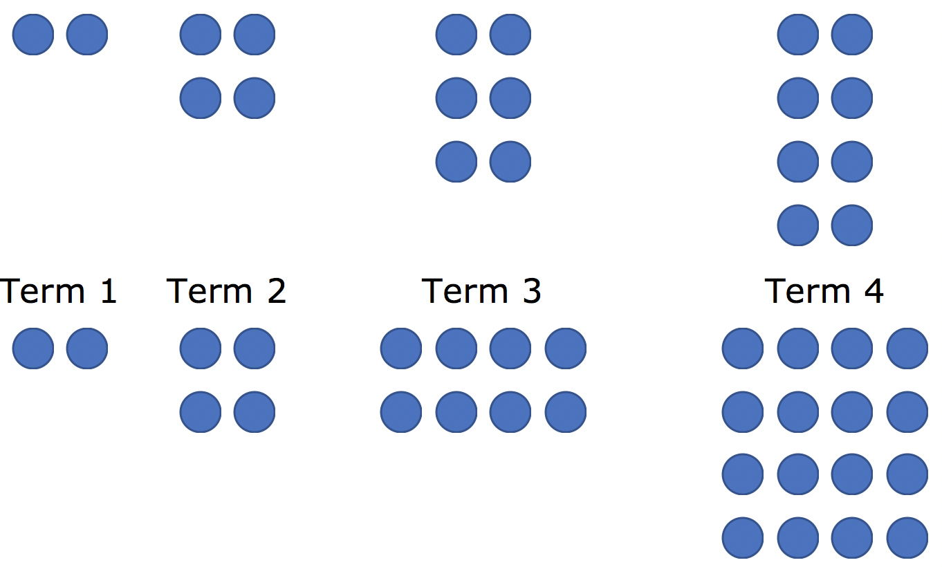
1.3.1 Warm-Up: Patterns
Pattern 1
Pattern 2
volume 1, pg. 14

Slide 7
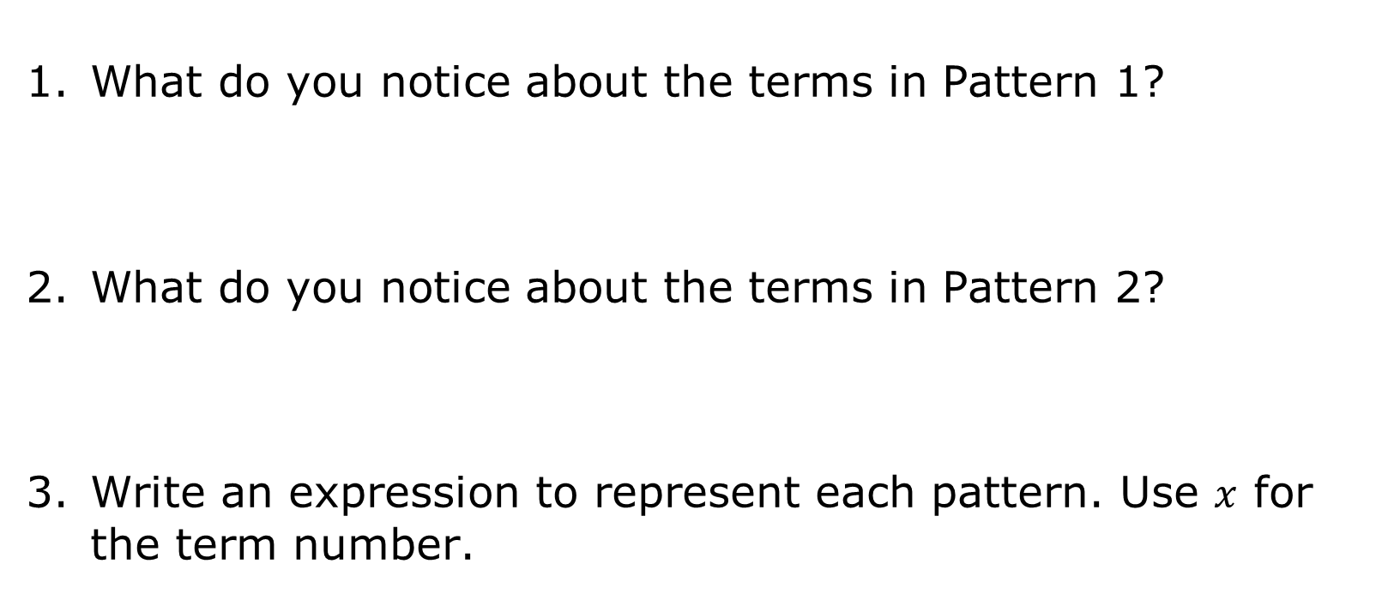
Pattern 1 | Pattern 2
volume 1, pg. 14

Slide 8

Guided Instruction
volume 1, pg. 14

Slide 9
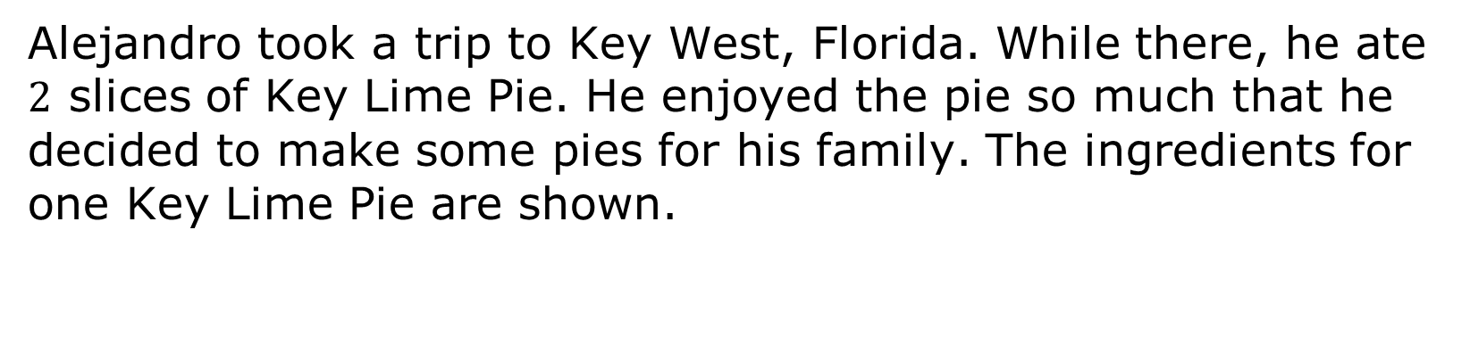
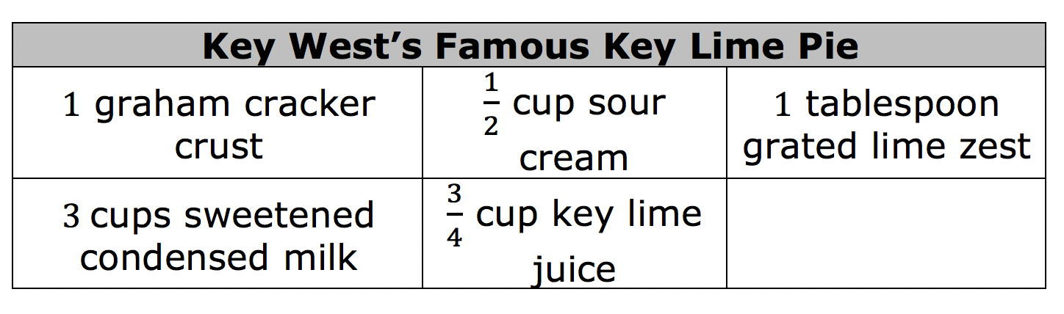
1.3.2 Guided Instruction: Multiplying Fractions
volume 1, pg. 14

Slide 10
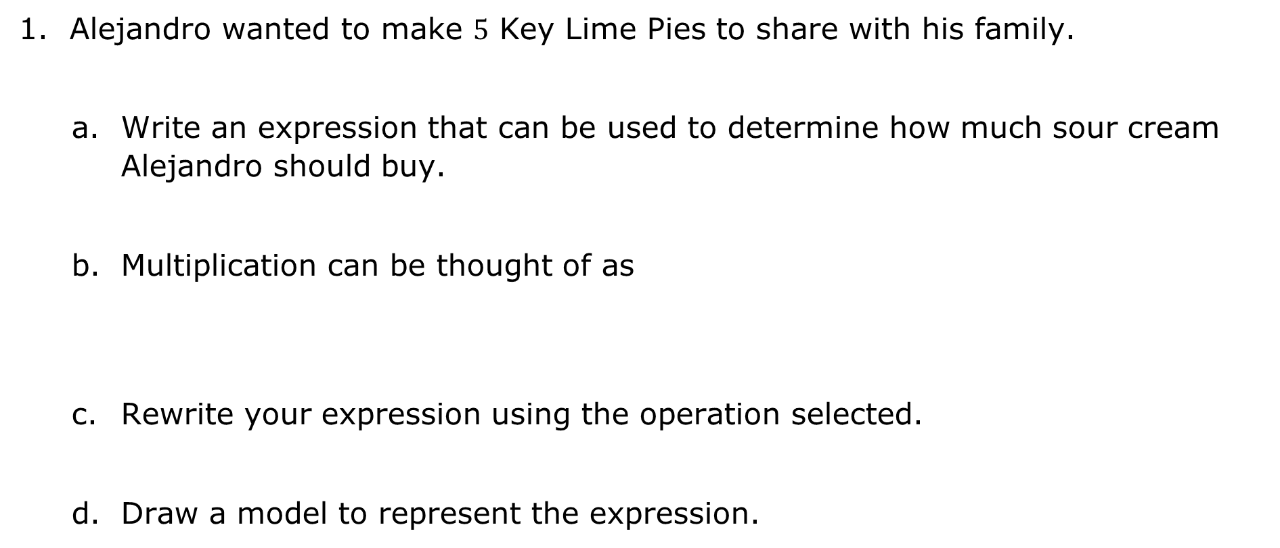
repeated addition.
repeated subtraction.
volume 1, pg. 14

Slide 11
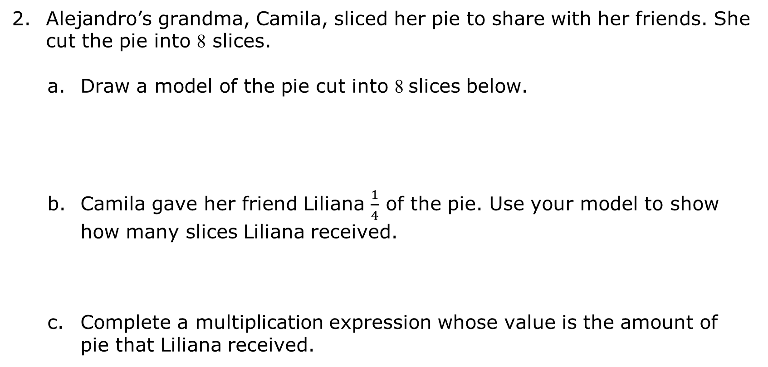
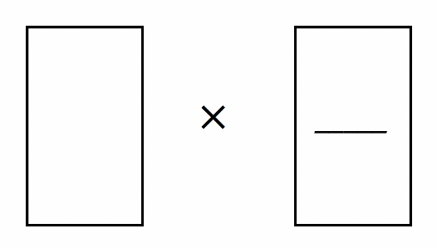
volume 1, pg. 15

Slide 12
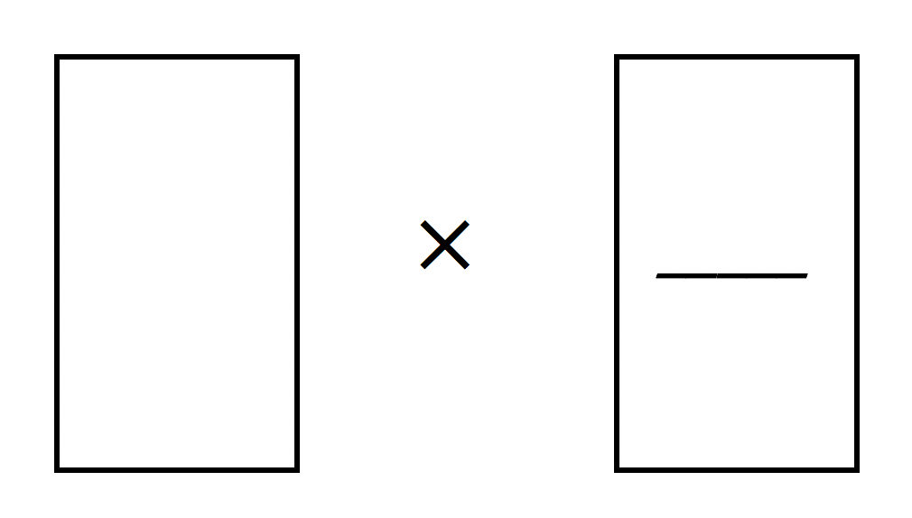
How many slices of the pie are left?
e. Complete a multiplication expression whose value represents the amount of pie that remains after Liliana received her slices.
volume 1, pg. 15

Slide 13
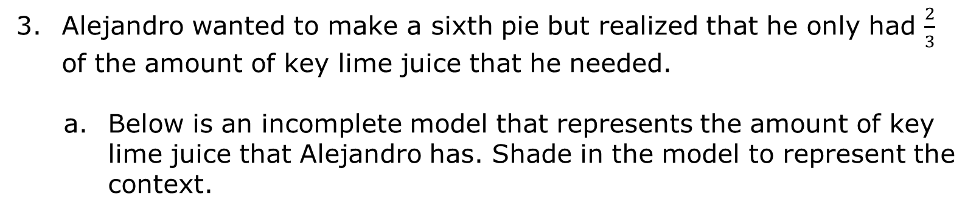
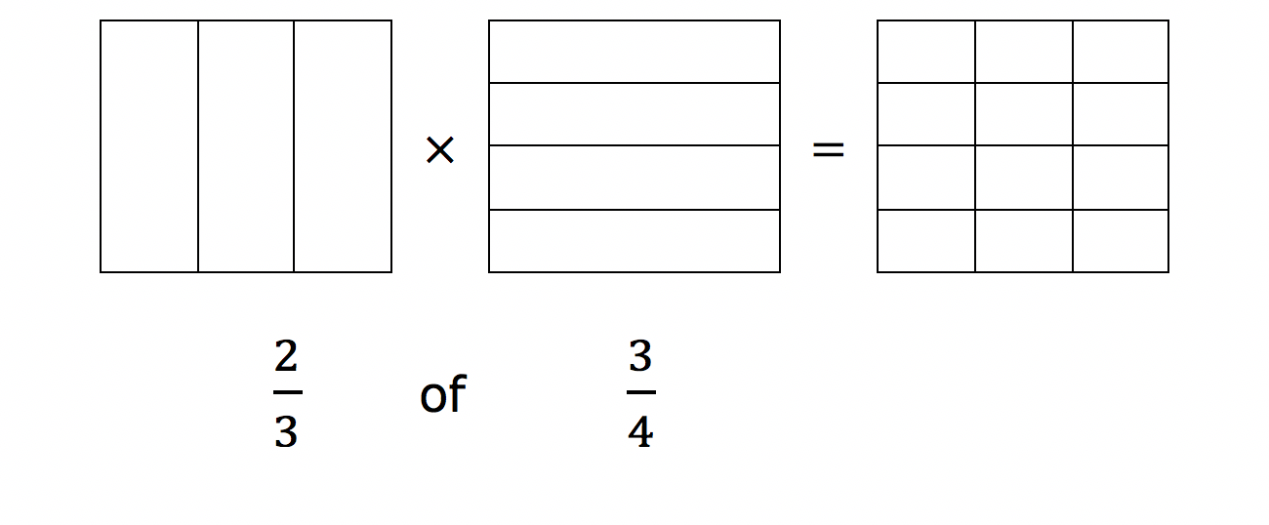
volume 1, pg. 15

Slide 14
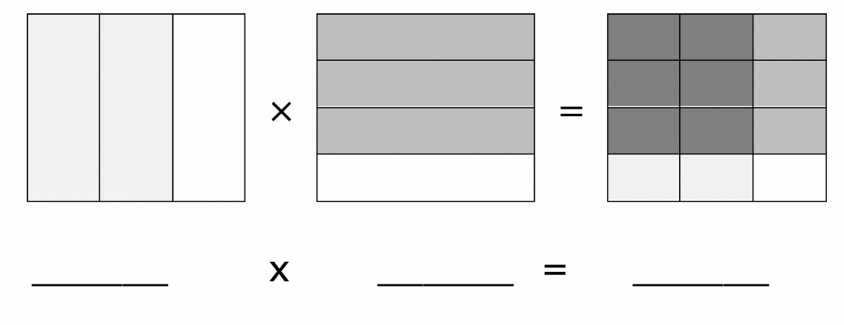
The diagram of three figures shows the complete model that represents the amount of key lime juice that Alejandro has. When the first two figures in the diagram are placed on top of each other, the result would be the third figure. In the third figure, the denominator represents the total parts. The numerator is represented by the number of parts where the shading overlaps. Fill in the fractions to complete the equation below the model.
c. How much key lime juice did Alejandro have?
volume 1, pg. 16

Slide 15
When multiplying fractions, the numerator of the first factor is multiplied by the of the second factor. The denominator of the first factor is multiplied by the of the second factor. Simply put, when multiplying fractions, multiply
numerator
denominator
numerator
denominator
straight across.
diagonally (cross-multiply).
volume 1, pg. 16

Slide 16
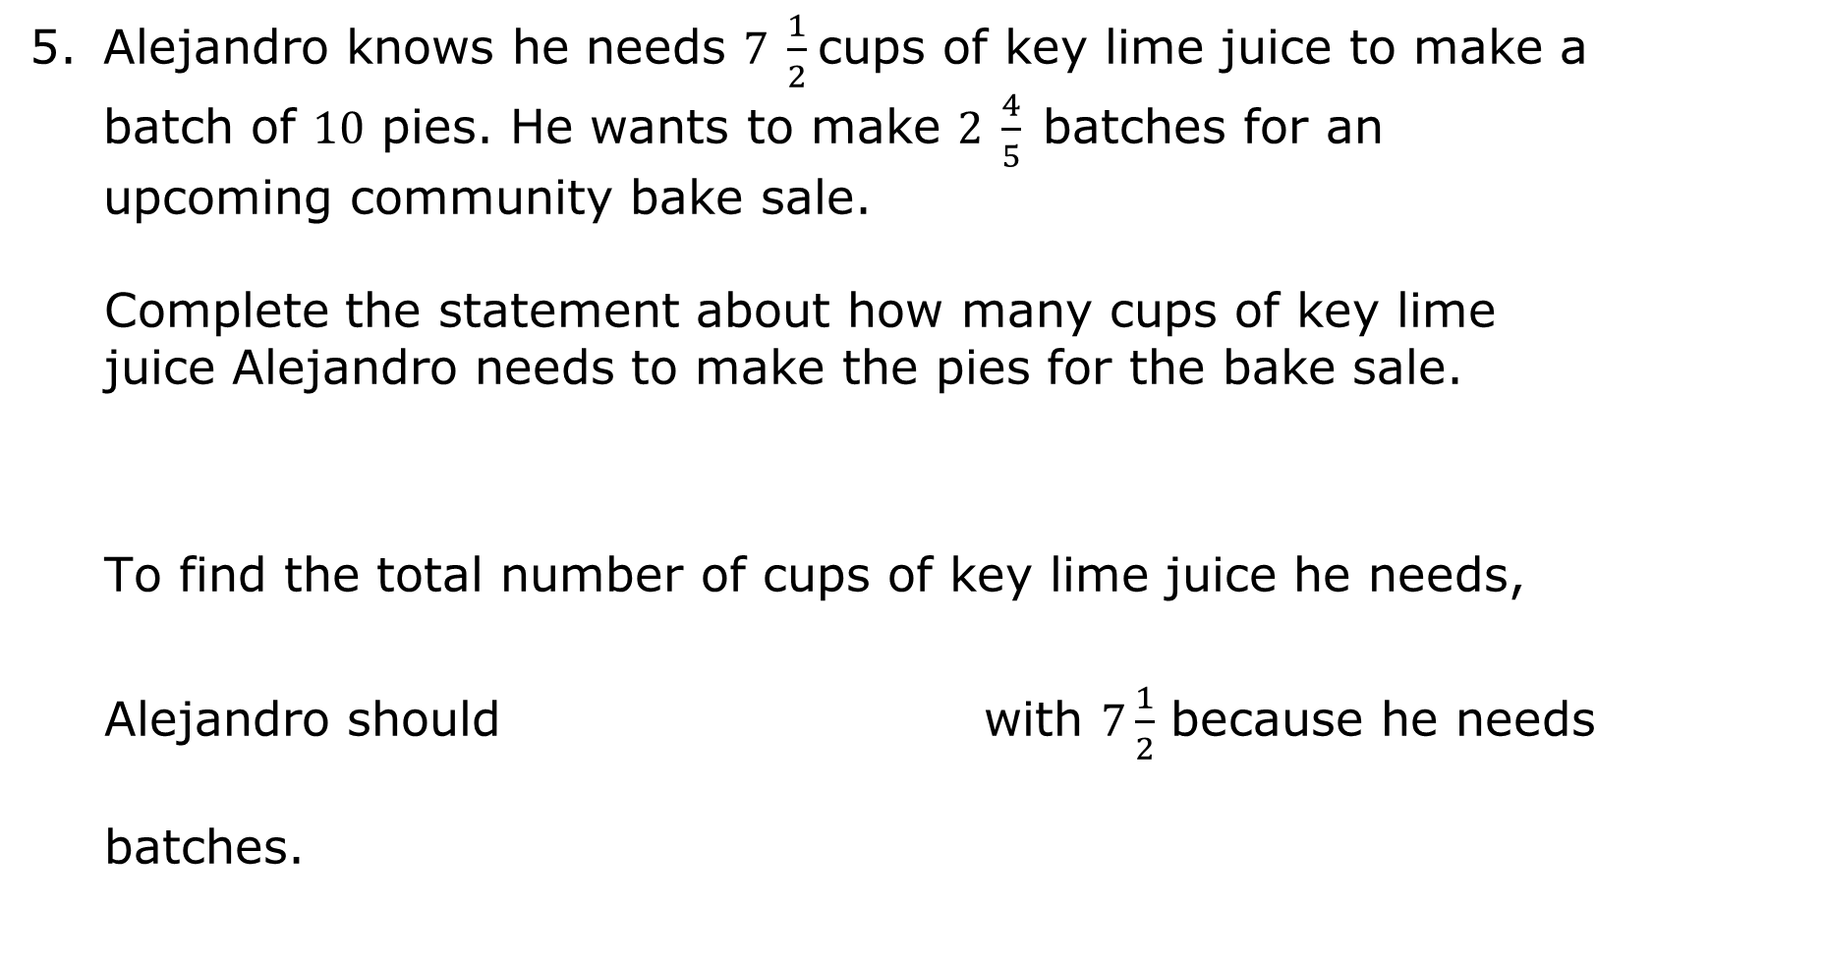
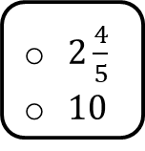

add
multiply
volume 1, pg. 16

Slide 17
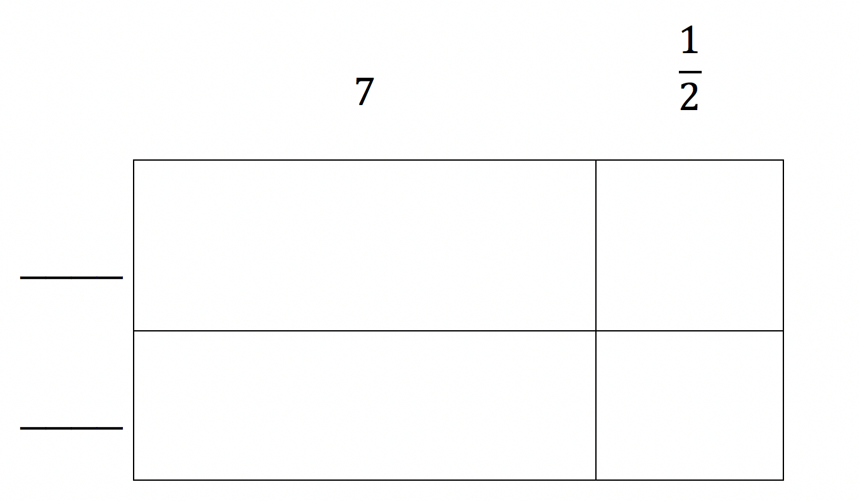
When multiplying using mixed numbers, an area model can be used.
Complete the left side of the area model with the missing factors, and then find the product for each box.
b. Add the values from each box together to find the total number of cups of key lime juice.
volume 1, pg. 16

Slide 18

Guided Practice
volume 1, pg. 17

Slide 19

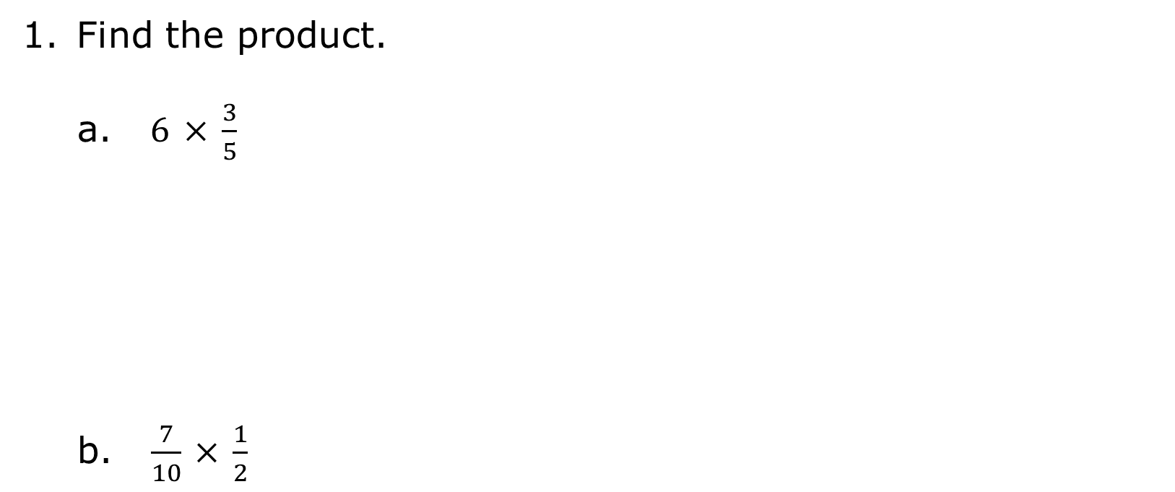
1.3.3 Guided Practice: Multiplying Fractions
volume 1, pg. 17

Slide 20
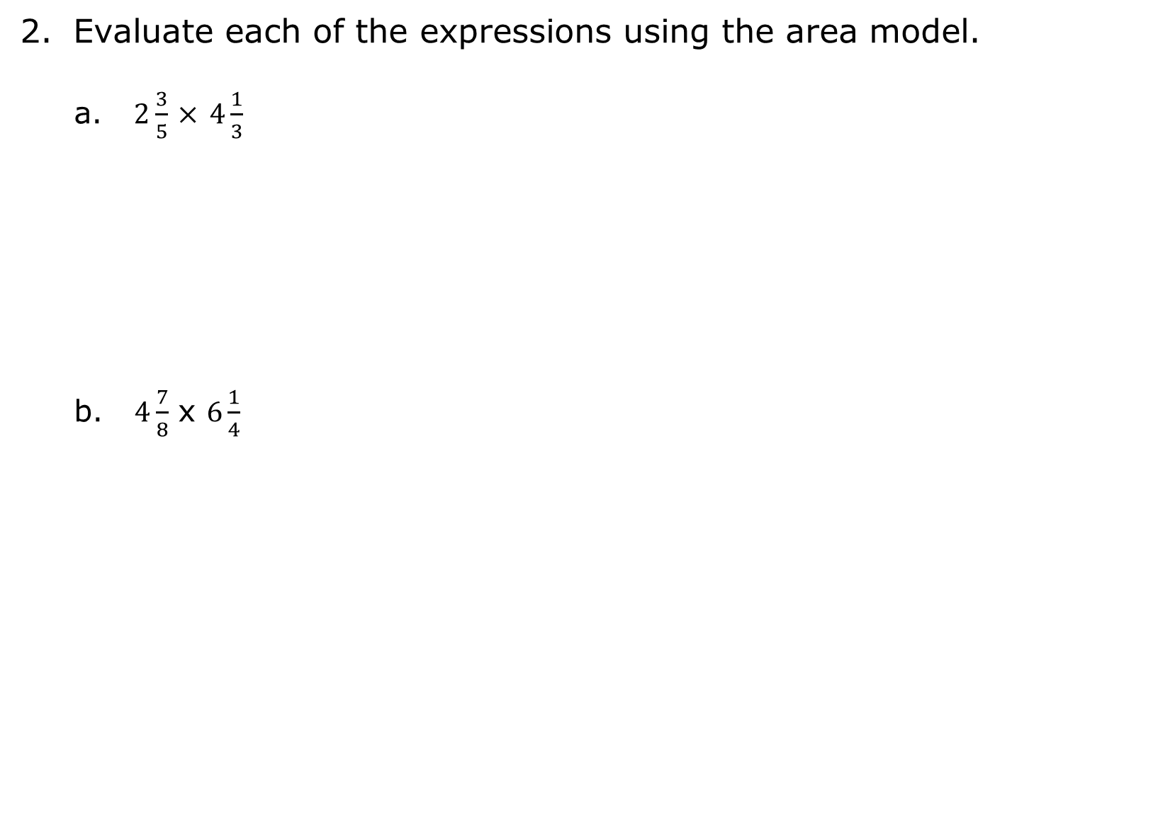
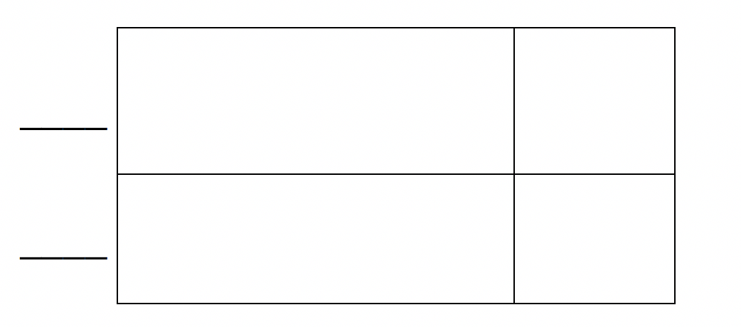

volume 1, pg. 17

Slide 21

Collaboration
volume 1, pg. 17

Slide 22

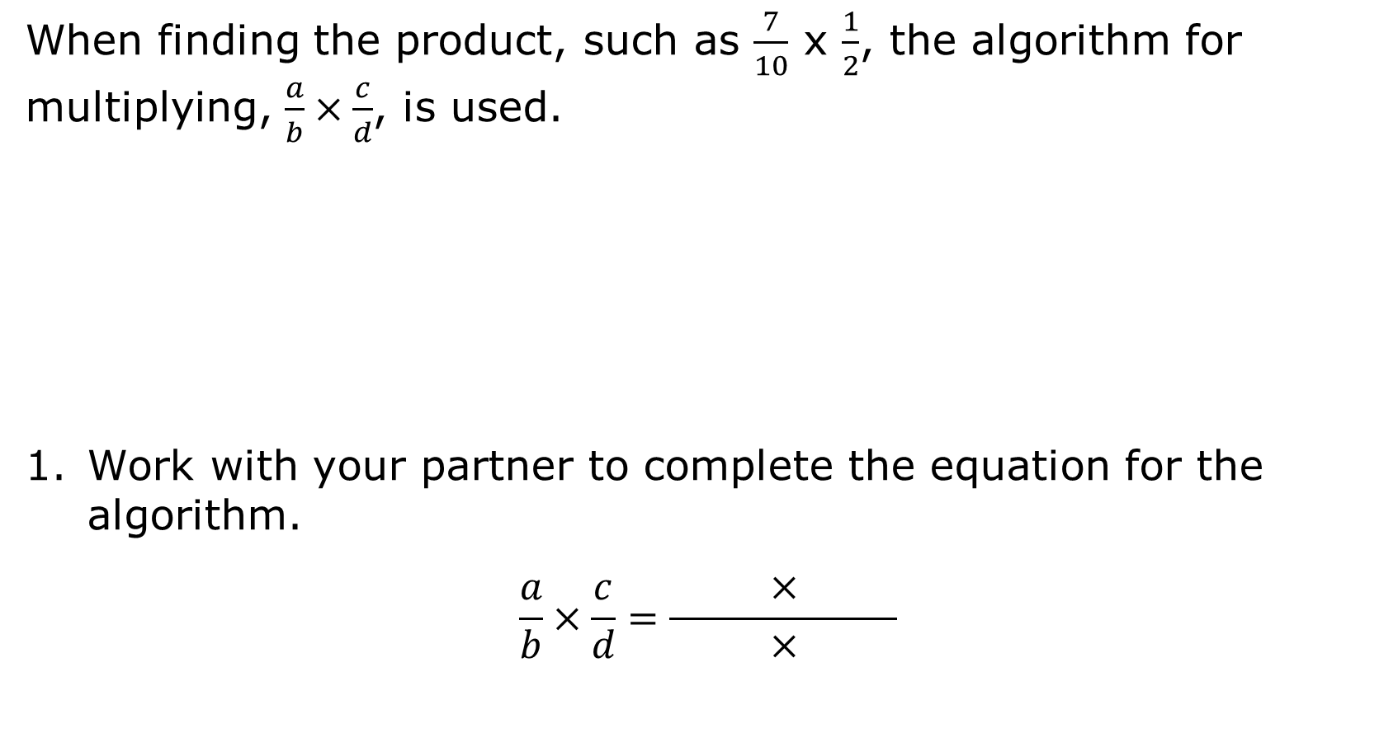

1.3.4 Collaboration: Multiplying Fractions Greater Than One Using an Algorithm
volume 1, pg. 17

Slide 23
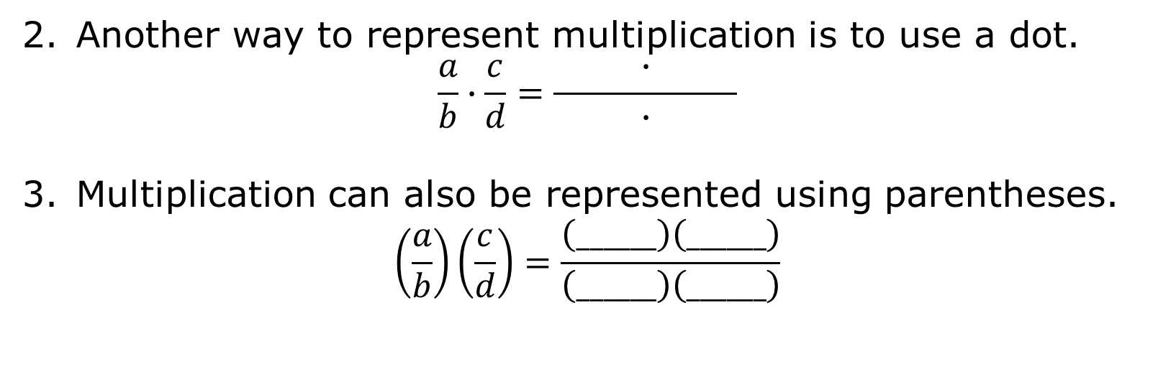
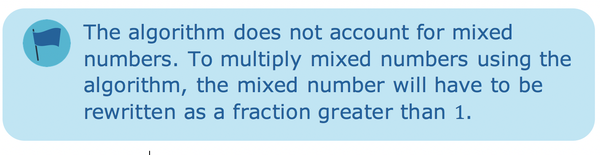
volume 1, pg. 17

Slide 24
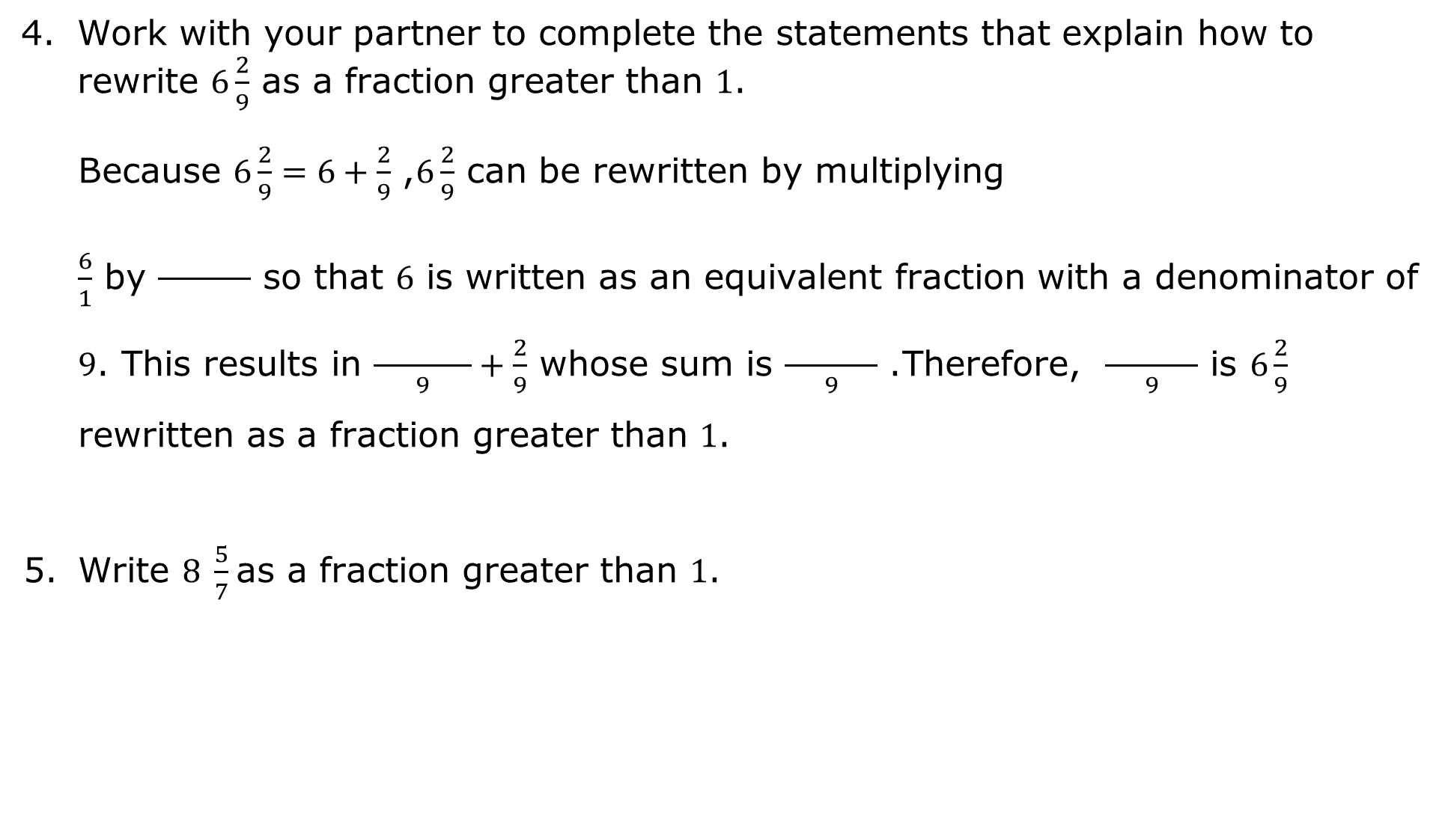
volume 1, pg. 18

Slide 25
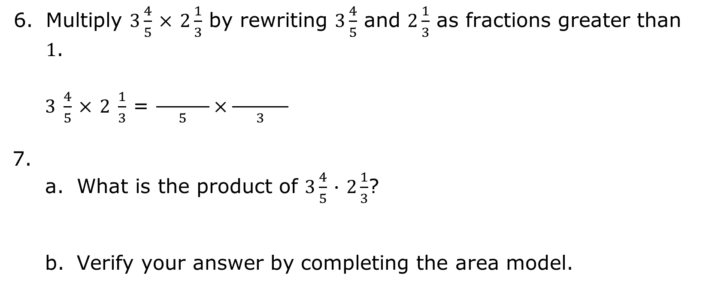
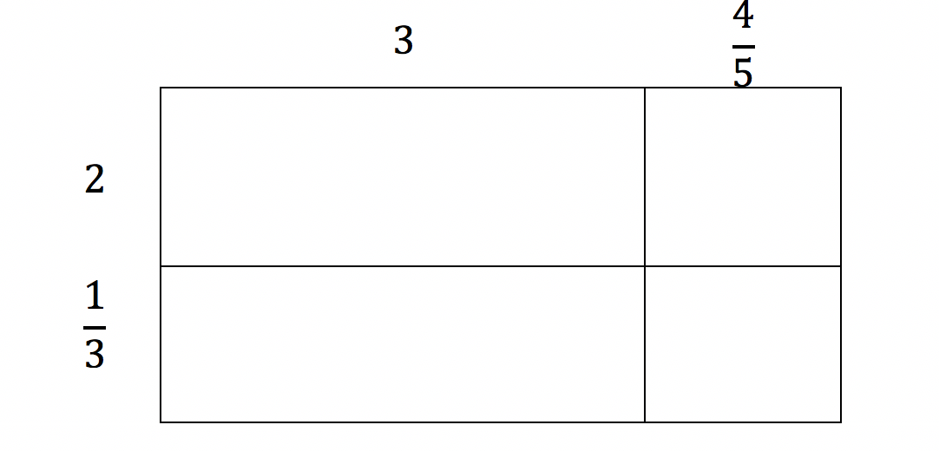
volume 1, pg. 18

Slide 26

Wrap-Up
volume 1, pg. 18

Slide 27
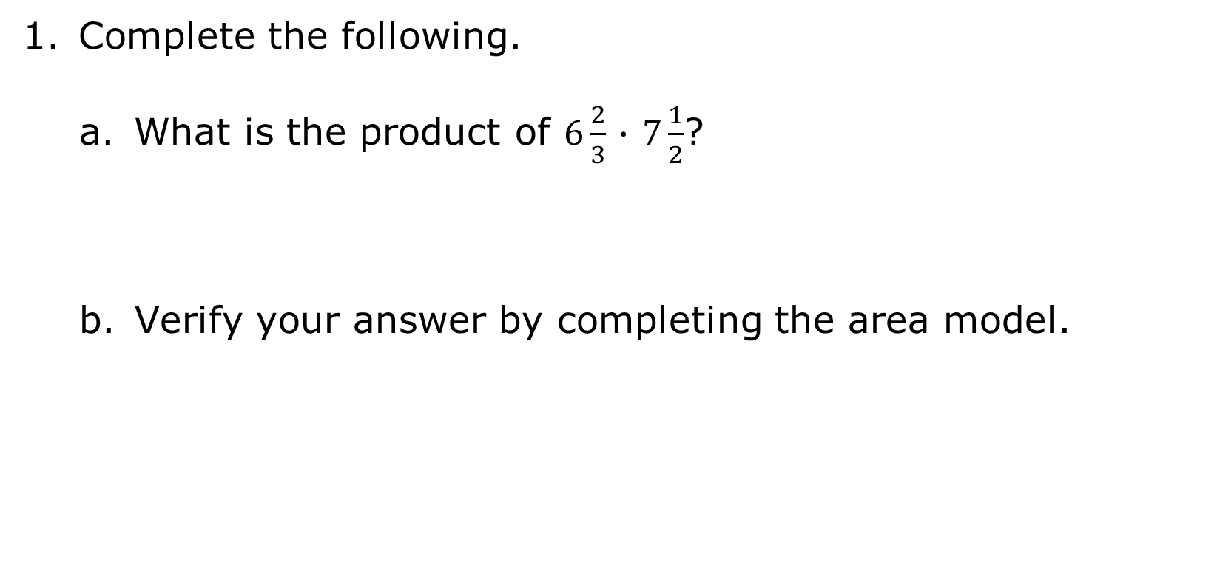

1.3.5 Wrap-Up: Ticket Out the Door
volume 1, pg. 18

Slide 28
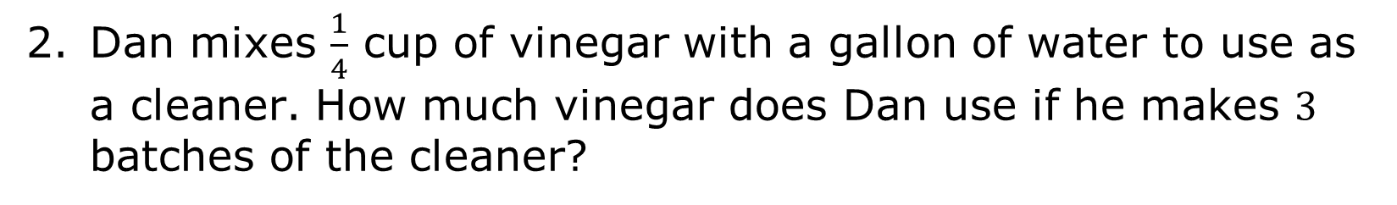
volume 1, pg. 18

